Slide 1
ETIHAD SMART CONTRACT SOLTION TO AUTOMATE CONTRACT MANAGEMENT

Slide 2

AUTOMATION THROUGH SMART CONTRACT
Overview:
Contract management in Etihad Aviation Group involves various manual transactions. Emerging technology of blockchain has the potential to transform these process. Inspired by GCEO challenge, this project is to demonstrate the potential of this technology.
Current State
Proposed Solution
Benefits
Manual process
Paper based contracts and storage of documents
Multiple iteration and exchanges between internal and external
Involve multiple versions and tedious and laborious to review and retrieve
Digitized and end to end automated process
Single repository and enhanced collaboration
Reduced effort and efficient
Consistency and accuracy
Traceable and immutable
Fully Automated Smart Contract
Using Blockchain
Project Update
Team
Subir Ghosh
Amitabh Cheekoth
Balasubramanya Ramaswamy
Vinod Thottupurath
Blockchain based smart contract developed for Landing Gear overhaul contract

Slide 3
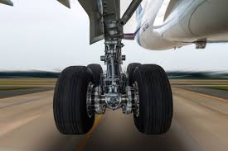
BUSINESS SCENARIO
Background:
Etihad has more than 1000 active contracts with various Service Providers. Huge amount of manual work is involved to establish these contracts and maintain them through execution and amendments during the contractual period.
The objective of this exercise is to develop an automated solutions that can replace current manual contract management. The automated solution will be end to end digitised.
Next generation smart contract based on blockchain is considered to develop this solution. Blockchain technology is transforming industries through its power immutability, trust and distributed assets.
To illustrate the potential of blockchain and smart contract real business scenario of how Etihad Strategic Contracts team establish and manage a contract with a third party maintenance unit for Landing Gears.

Slide 4









BUSINESS SCENARIO
Chris represents Strategic Sourcing and responsible for many engineering contracts. Based on the fleet plans and aircraft maintenance records, Chris determines Landing Gear overhaul requirement by fleet type. Chris floats and RFP to the market and receives responses.
A word template of contract is floated to service providers as part of RFP. Responses for RFP are received by email. Chris then ask the service provider to submit an excel sheet, a summary of changes made to the original template while responding to RFP. | Manual documents and process
When the responses are received Chris goes through these word documents line by line and reviews variations., Review becomes tedious as each variation needs to be understood and evaluated separately. | Tedious manual review subject to interpretation of words
Review goes through multiple iterations and finally Etihad and service provider agrees on the scope of work and associated commercials. Chris then takes the contract to Legal. Legal reviews the contract and make changes as relevant. Multiple versions of the drafts are exchanged at this stage between Etihad and service provider. | Email with multiple versions of draft contract exchanged.
Once the contract is agreed by all stakeholders, printed contracts goes through authorised signatories of Etihad and service provider, Chris handover signed contract to Legal, where it is filed. | Manual contract approvals and storage
During the contract life, Chris receives changed work instructions from manufacturers as well as changes in the schedule of overhaul. These changes are agreed with service providers through addendums. Sometime Chris has to maintain twenty odd amendments to each type of landing gear. | Tedious manual process to track changes
Current
Process

Slide 5




PROPOSED SOLUTION
Chris creates an electronic RFP and broadcast to selected network. Service provides submit their responses by accessing the network GUI. | Fully automated. Digital values instead of text and documents
Chris and legal team reviews the responses through their Multi-device GUI access. All stakeholders works in collaboration and completes the Contract. | Collaborative. Transparency and visibility
Contract when agreed through collaboration gets approved electronically and stored in digital form for execution. | Digital approval/ signature Trust Central repository
Changes in overhaul procedure or timeline gets amended online and agreed in collaboration. Chris can go and trace back any stored contract using any of the attributes. | Traceable and transparent central repository Immutable
This pic needs enhancements
Placeholder to brief tech

Slide 6
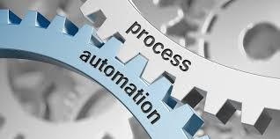


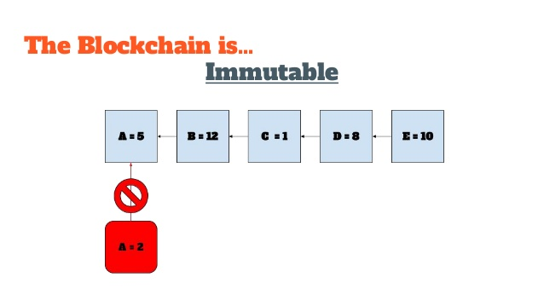




BUSINESS BENEFITS
Smart Contract:
Smart contract are based on special algorithms for the automation of contracts including sourcing, selection and contracting phases.
End to end automation of contract management process, replacing current manual elements.
Trust: built on a distributed network in collaboration completely transparent manner.
Efficiency in the process of establishing contracts and maintaining the contract execution during the period of contract.
Contracts made or changed are stored in a digital ledger, Immutable.
Safety: stored in a decentralized registry cannot be lost and cyber attacked.
Precision in execution, reducing errors, risks (potential for reduced litigation)
Central repository in everyone works in collaboration.
Reduces human participation in transactions, everything is done by the prescribed programm code;

Slide 7
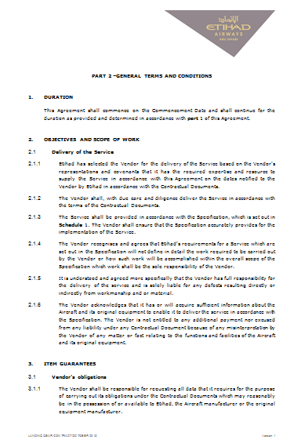
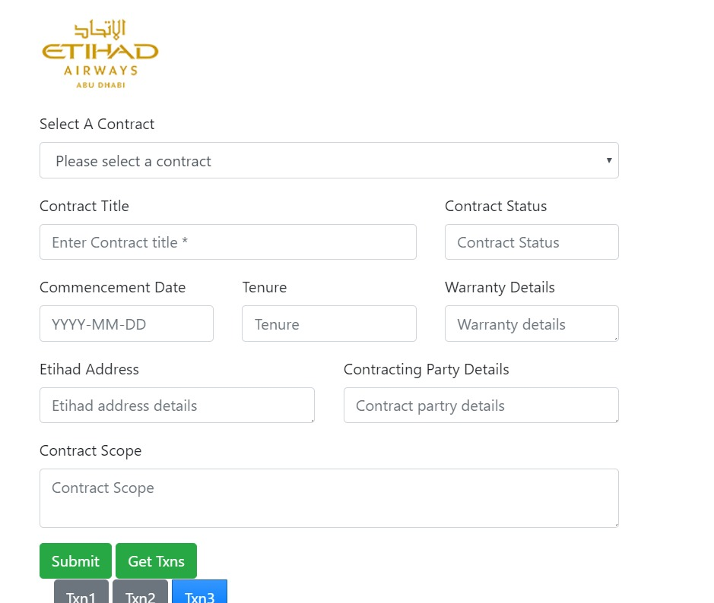
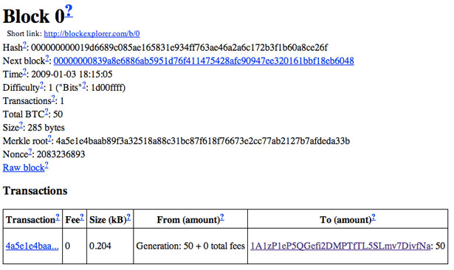
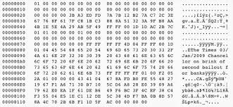
APPROACH OF AUTOMATED CONTRACT EXPLAINED
Traditional document based contract
GUI for collaboration and retrieval
Encrypted codes and ledger of transactions
Contractual information is stored digitally

Slide 8
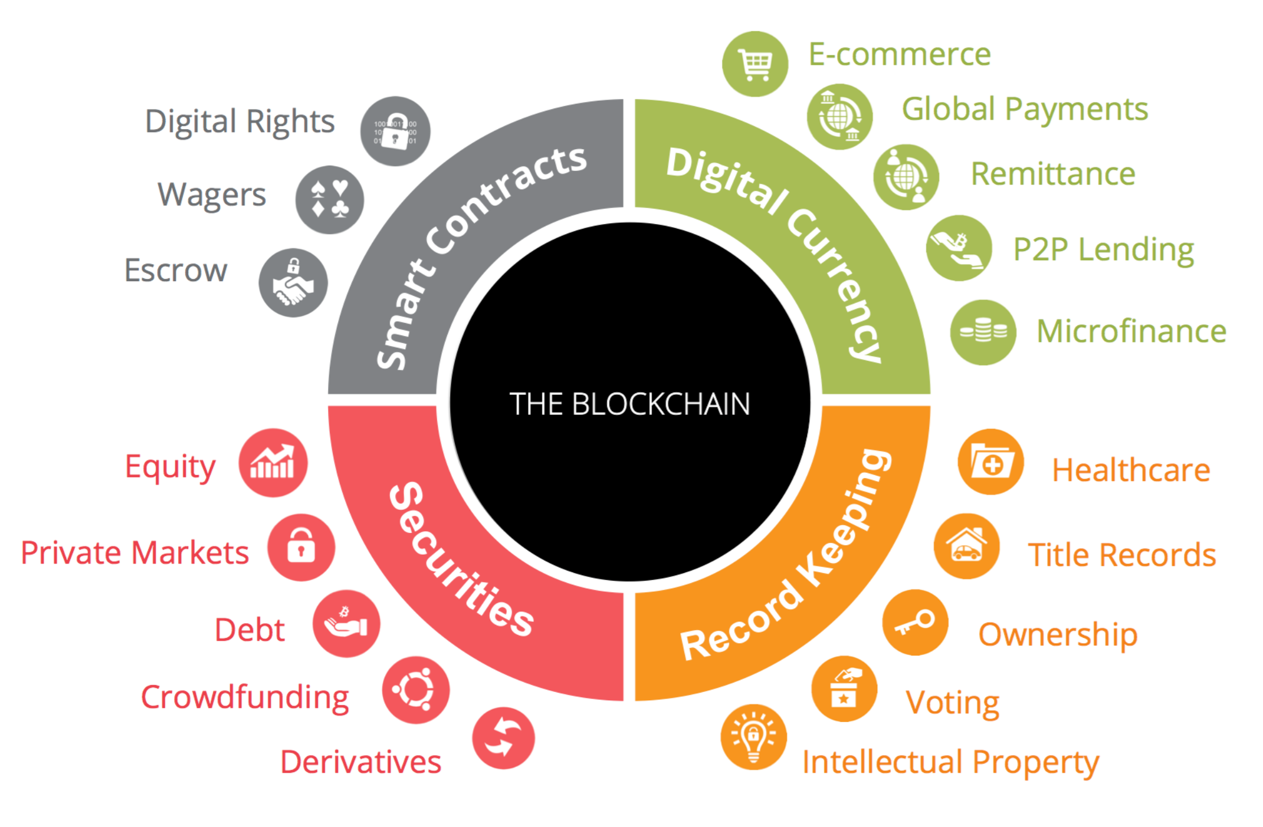
TECHNOLOGY EXPLAINED
Blockchain:
Blockchain technology is radically transforming the transaction based processes and industries.
tbd
TBD
TBD
One of the emerging application is supply chain and self executing B2B contracts.
Placeholder to elaborate tech

Slide 9
SMART CONTRACT TOOL DEMONSTRATED

Slide 10
INITIAL TEMPLATE AT BROADCAST || RFP STAGE
PLACEHOLDER
FRONTEND DESCRIPTION
PLACEHOLDER
BACKEND DESCRIPTION

Slide 11
SERVICE PROVIDER INPUTS RESPONSE || RFP RESPONSE STAGE
PLACEHOLDER
FRONTEND DESCRIPTION
PLACEHOLDER
BACKEND DESCRIPTION

Slide 12
COLLABORATIVE REVIEW || SUPPLIER SELECTION
PLACEHOLDER
FRONTEND DESCRIPTION
PLACEHOLDER
BACKEND DESCRIPTION

Slide 13
DIGITAL CONTRACT || APPROVAL AND DIGITAL SIGNATURE
PLACEHOLDER
FRONTEND DESCRIPTION
PLACEHOLDER
BACKEND DESCRIPTION

Slide 14
ADDENDUM || AMENDMENTS DURING LIFE OF EXISTING CONTRACT
PLACEHOLDER
FRONTEND DESCRIPTION
PLACEHOLDER
BACKEND DESCRIPTION

Slide 15
BACKEND SYSTEM EXPLAINED

Slide 16
BACKEND SYSTEMS
PLACEHOLDER

